Slide 1
2023 Parent Information Meeting
September 27, 2023

Slide 2
Mission Statement
Perkiomen Valley Aquatic Club’s mission is to develop and enhance competitive swimming and diving skills, to help athletes reach individual goals and to promote teamwork and sportsmanship.

Slide 3
Team Structure
Suburban Aquatic League(SAL)
USA Swimming (PVAC-MA)
Over 170 swimmers & divers ages 6-18 make up our competition team.
Season runs late October through January.
Swim/dive dual meets Nov-Jan, plus Invitational meets.
~20 teams in Montgomery, Bucks and Delaware counties.
Champs eligibility based on times.
More info: www.suburbanaquatic.org
Add-on to our competition team /encouraged for our more competitive swimmers.
Additional events/longer distance, meets against other swimmers not teams.
Season starts early September-late March.
Focus on individual times, personal swim goals. PVAC attends USA meets and swimmers, with head coaches' guidance, choose their own events.
More info: www.maswim.org

Slide 4
Organization Structure
PVAC is a parent-run team organized under the PVSD Community Education Program.
Under PVSD Community Education:
Use PVHS pool, classrooms.
Insurance coverage.
Payroll of coaches and lifeguards.
PVAC’s Board:
President | Jim Melwert | Co-USA Reps | Jen Gutshall
VP / Webmaster | Bryan Chain | SAL Rep Girls | Amanda McPhillips
Treasurer | Vaishal Patel / Shawn Berwager | SAL Rep Boys | Erin Battisto
Secretary | Jessica Helwig | SAL Rep Diving | Kristy Crothers
President Emeritus: Duane Gutshall

Slide 5
Coaching Staff
PVAC Coaching Staff:
Head Coach : Mitchell Zackowski
Lead Girls Coach: Emily Angst
Lead Boys Coach: Martin Zackowski
Lead Diving Coach: Kayla Kengle
Lead USA: Mitchell Zackowski
Assistant Swim Coaches:
Kyle Dix
Tom Hayes
Becky Strawbridge
Ryan Keenan
Andrew Derrick
Assistant Dive Coaches:
Griffin Crothers
Jordyn Gutshall

Slide 6
Swim/Dive Parenting
Support your swimmer/diver by:
Bringing them to practices and meets
Volunteering at meets
Every meet requires numerous workers, DO NOT ASSUME that someone else will do it!
Support the snack bar
Learn a job that requires training (esp. Stroke and Turn and Table/Computer)
Boys rep: Erin Battisto
Girls rep: Amanda McPhillips
Diving rep: Kristy Crothers
Participate in the running of our PARENT-run club
Inquire about open board positions in the coming year
Take on managing a fundraising activity
Help organize Fall Fest and other events

Slide 7
PVAC Operating Budget

Slide 8
Fundraising
Clothing and Electronics Drive
PV SOUTH - October 7, 1:00-2:00 pm drop off
Still need volunteers to take donations and load the truck!
Fall Fest Sunday October 29
PVAC’s own invitational meet
Biggest fundraiser
Spirit Wear – Open Now!
Snack Bars
Flyer's watersports night 11/28/2023
Reading Royals (Ice Hockey) – 12/29/2023
All funds raised are used to ensure the future of the club, to help pay for Ursinus rental, and to help offset future fee increases.

Slide 9
Volunteering
Volunteer sign up is through PVAC’s Team Unify website.
Requirements:
Fall Fest
3 meet jobs during the regular season (Oct-Dec)
1 meet job during the post season meets (Jan)
Mandatory sign up for Division Championships & Leagues(late Jan /early Feb)
Request one additional volunteer opportunity outside of meets
Stroke and Turn or Starter/Ref. training, especially for BOYS meets!
October Clothing Drive

Slide 10
PVAC - Team Unify
PVAC-TU
Registration
Invitational entries
Volunteer sign up and tracking of requirements
Snack bar sign up
Access to your swimmer’s times
Searchable directory of members
Ability to send text alerts to entire team or individuals from the website or via the OnDeck App (available for Apple and Android)
OnDeck App
Provides access to the team announcements, calendar, and meet results.
Allows you to sign-up for volunteering jobs and declare swimmers for events!

Slide 11
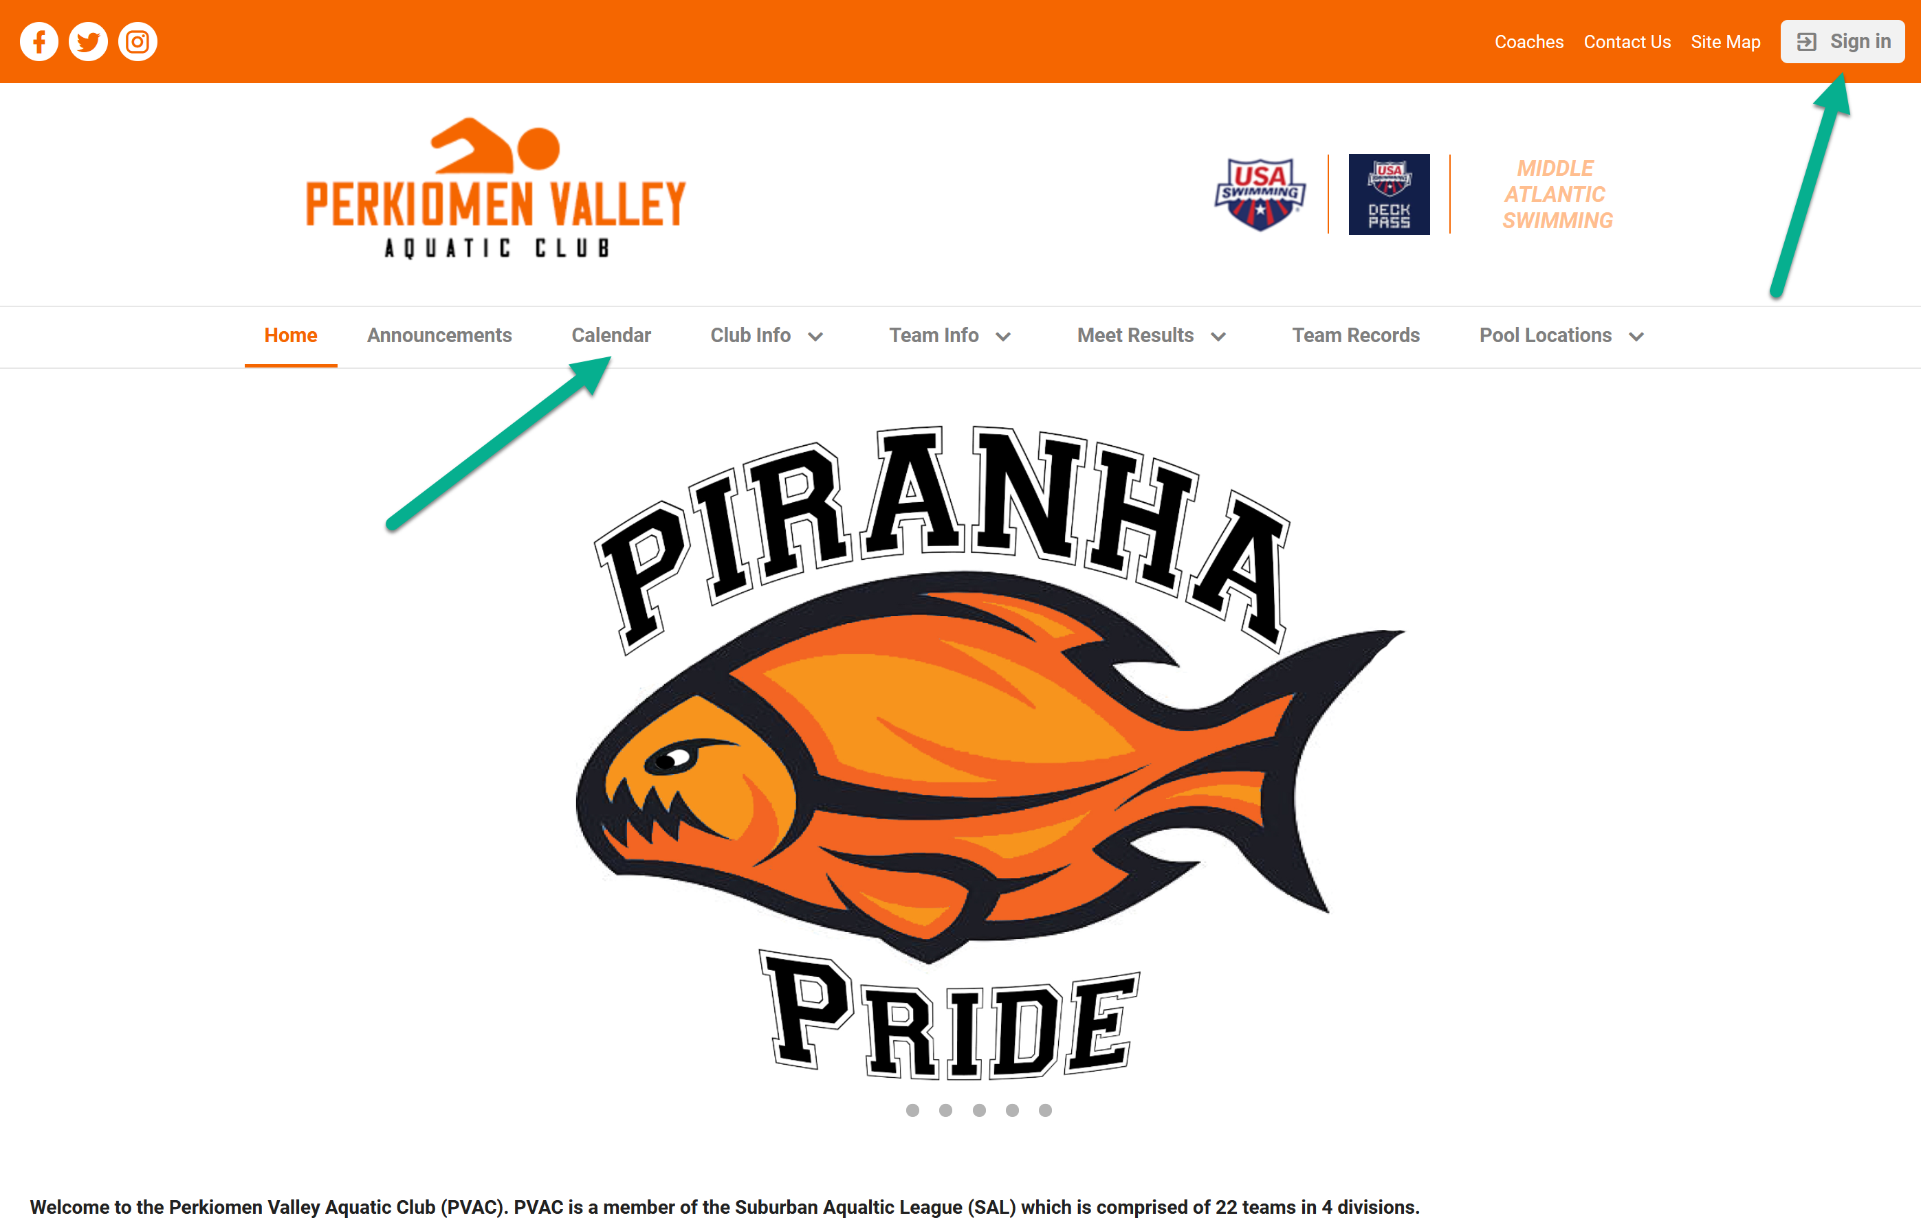
PVAC’s Website Overview
www.pvaquatic.com Web Address

Slide 12
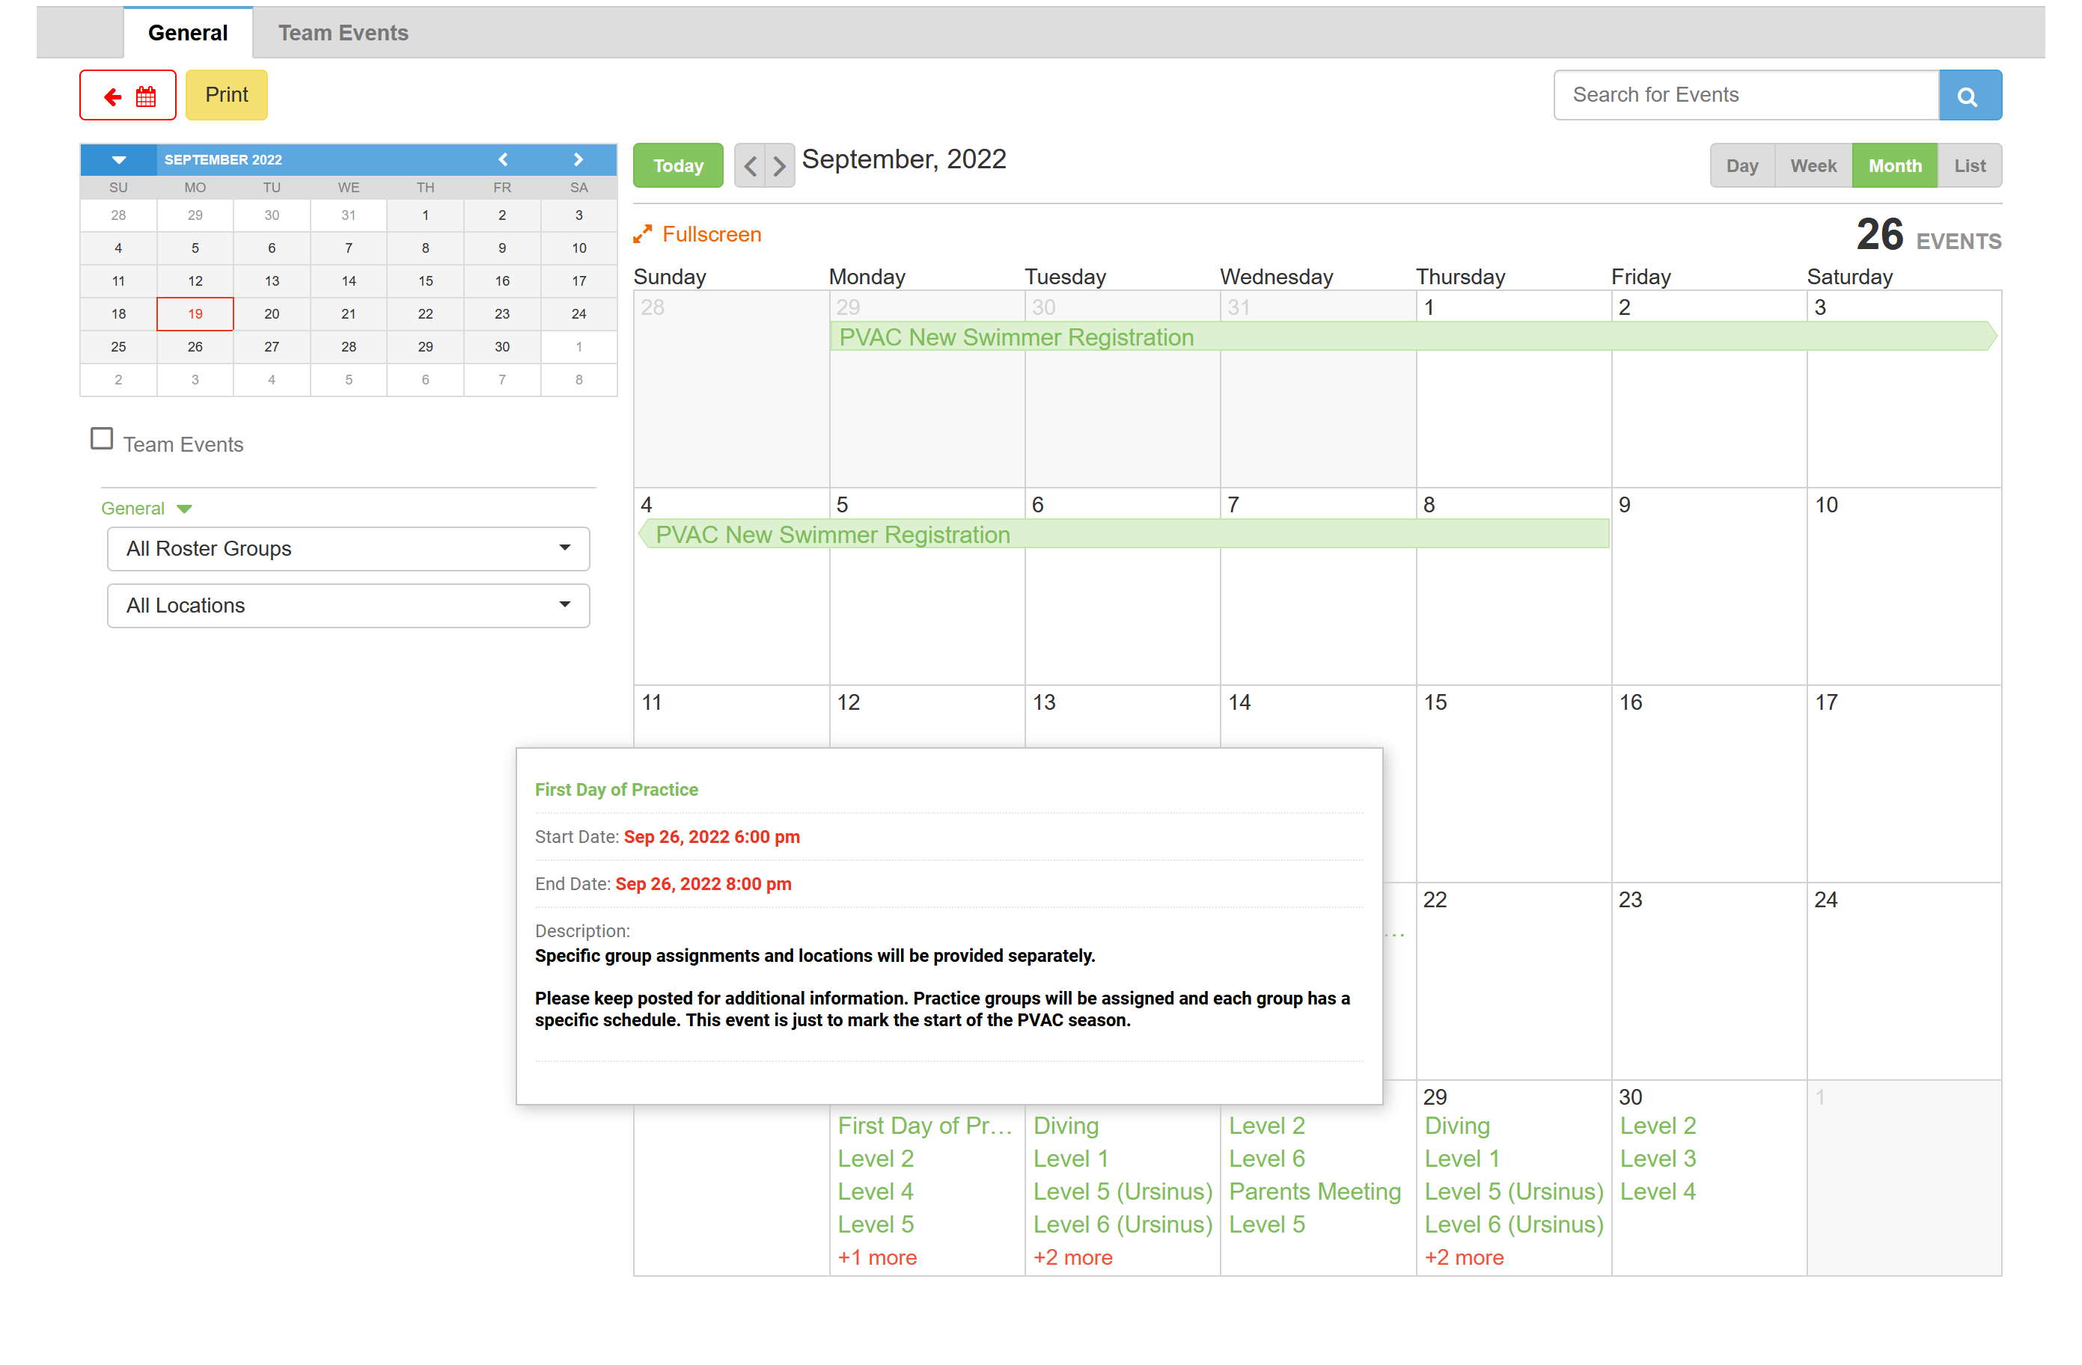
Calendar

Slide 13
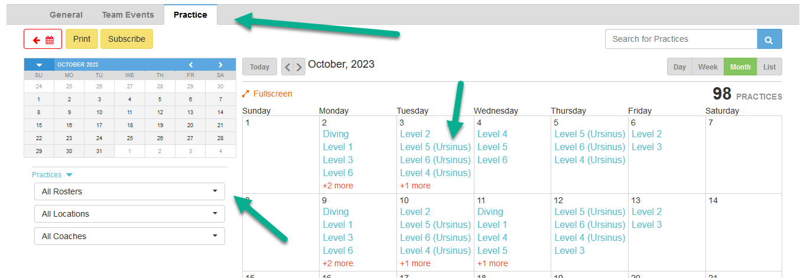
Practice Schedules/Calendar
Calendar is located on the front page of the website.
Does not require log in to view
Requires log in to register commitment for meets
General calendar will have all info and any events which do not require sign-up.
Team Events calendar will have meets and fundraisers.
Practice calendar will have the practice schedule.

Slide 14
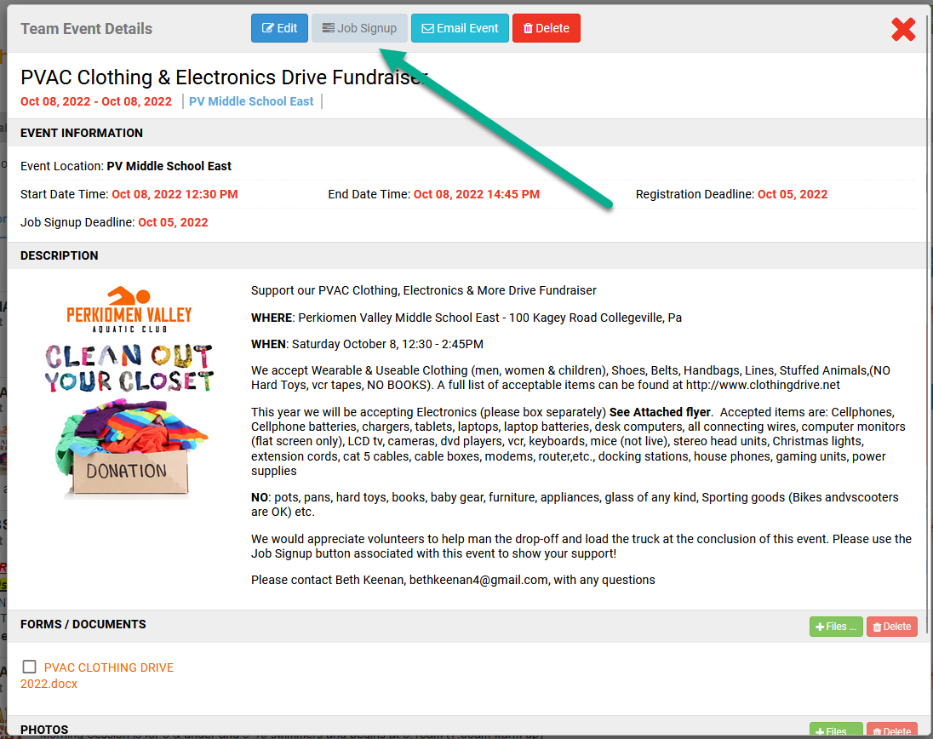
Volunteering Sign-Up

Slide 15
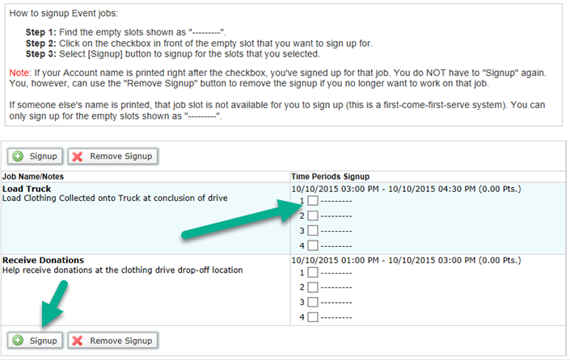
Volunteering Sign-Up

Slide 16
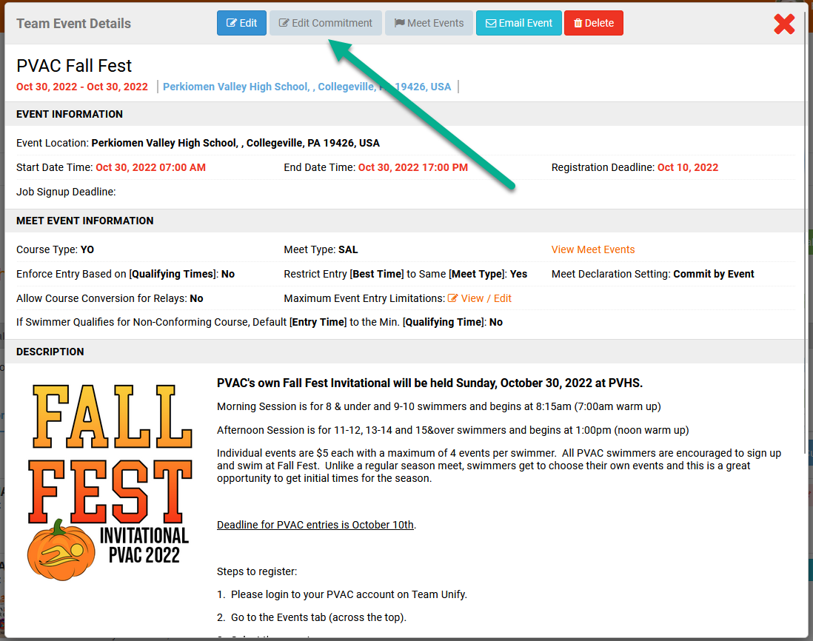
Swimmer Commitment

Slide 17
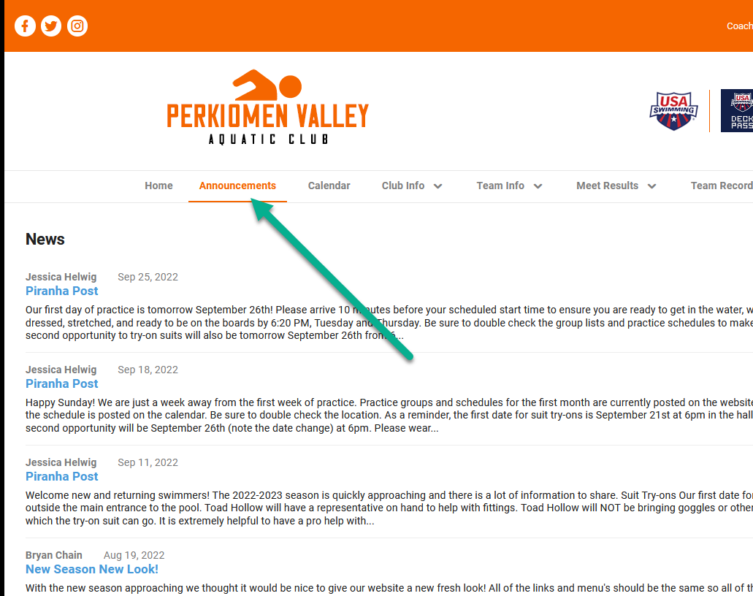
News / Announcements
The Piranha Post is our weekly newsletter, sent on Sundays. Will include important information as well as highlights from the weekends meets!

Slide 18
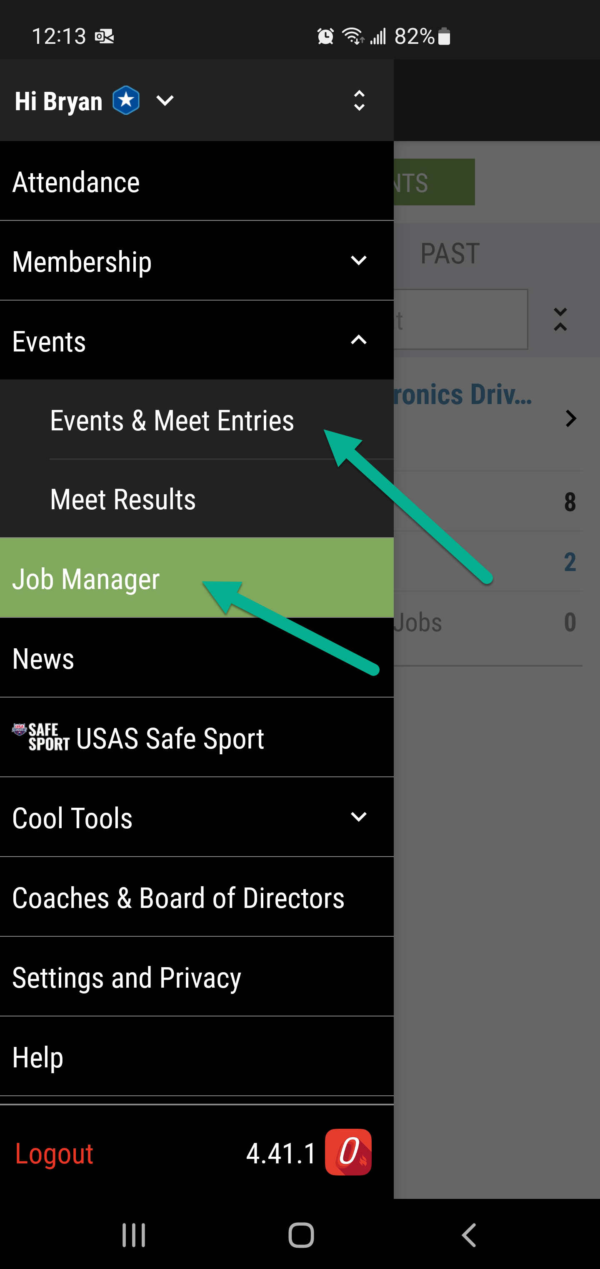
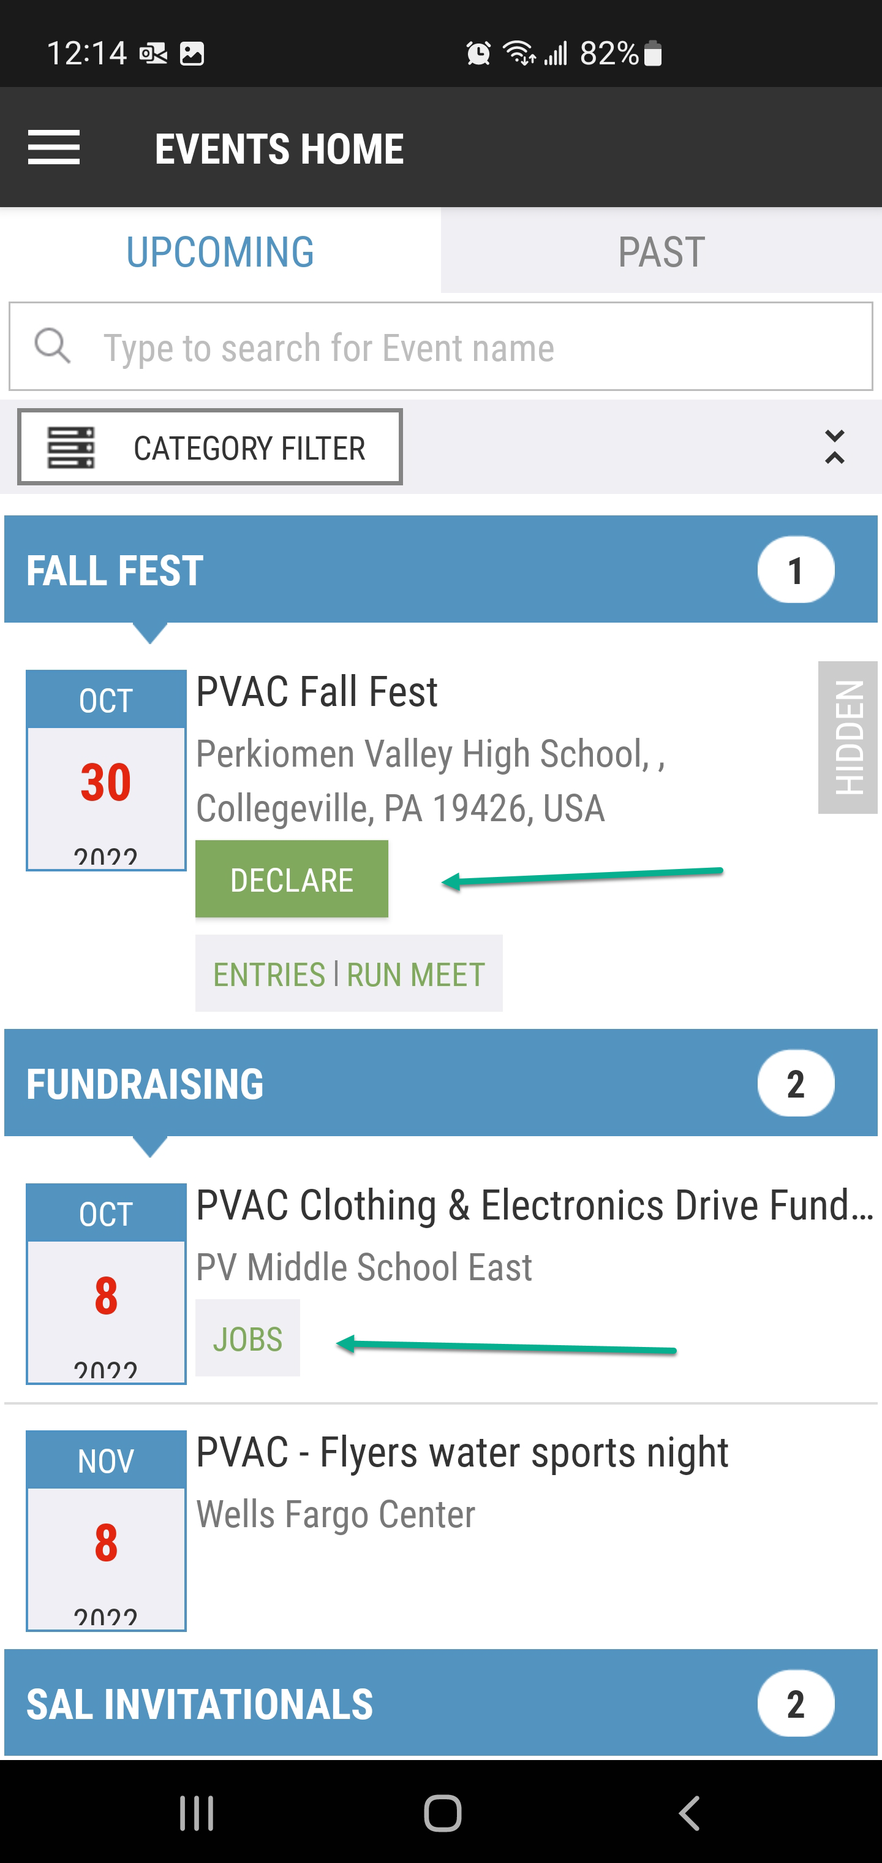
OnDeck App
The OnDeck App allows you to sign up for events as a volunteer as well as register swimmers for events.

Slide 19
Dive Team
Boys & Girls- 3 Age Divisions in each
Friday Evening Meets
Always looking for new members!

Slide 20
Practice Groups
Groups based on ability/swimmers needs.
Practice groups are determined by coaches!
Evaluations will run for the first two weeks of practice so the coaches can best place your swimmer in the correct practice group. All questions regarding groups should be directed to the head coach.
Group Lists are available/updated on website
Coaches will reevaluate as season progresses, change groups as needed.
Swimmer's practice with their assigned group
No practice hopping

Slide 21
Practice Expectations
Attend at least ½ of all scheduled practices
Parents do not need to notify coaches if their swimmer is missing practice unless it will be multiple times
More practices a swimmer attends, the more they will get out of the program
Arrive on time to practice.
Pay attention to coaches
Listen to directions (no heads underwater)
No goofing off
Respect teammates

Slide 22
Practice Etiquette: Athletes
Arrive on time to be behind the lane when practice begins.
No Glass on the Pool Deck, ever!
Please do not drop your swimmer off at practice without ensuring there is a coach present.
It is highly recommended you walk your swimmer into the building.
10& Under parents are expected to stay at practices for safety reason
Practice groups waits in the hallway until a coach instructs them to enter the pool.
Please be aware of divers when applicable.
Please respect that we are guests of the School District:
keep noise down in hallways
no playing or running in the hallways
no changing in the hallways and please clean up after yourself

Slide 23
Practice Etiquette-Parents
Parents are permitted to attend all practices, however, participation from the stands IS NOT permitted.
At no time should a parent be on the pool deck during practice.
Please refrain from coaching your swimmer from the stands.
Please remember to treat all our coaches, volunteers, other parents and athletes with respect.
NO FOOD/DRINK in pool balcony or deck – AND NEVER ANY GLASS in balcony/pool

Slide 24
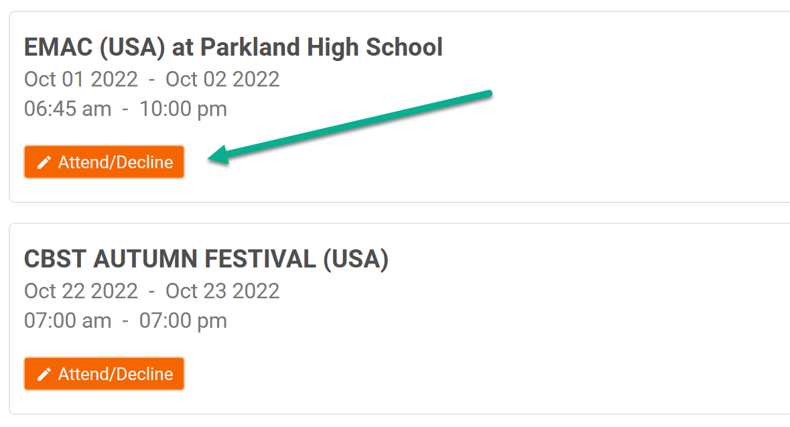
Dual Meets
Take place on Fridays (diving) and Saturdays (swimming); there are 7 throughout the year.
Meet attendance is important. One missing swimmer can affect the outcome of the meet.
Parents MUST [Accept/Decline] via Team Unify by Tuesday (midnight), the week of the meet.

Slide 25
Dual Meet Etiquette
Coaches spend roughly 5-10 hours /week preparing line-ups
[Accept/Decline] your athlete by Tuesday night
No-shows on day of meet affect the entire team
One change may affect up to 10 swims.
Last minute absences - email Mitchell ASAP
Be courteous
Arrive 30 minutes before warm-up
Great sportsmanship
Shake hands after every race
Wait until everyone is finished before getting out of the water
Stay in the team area. Cheer on your teammates!
No Soda! Water or Gatorade please!

Slide 26
Invitational Meets
Optional meets.
Typically held on Sundays.
Pay to swim. Additional, small ($5 fee/event) fee.
PVAC Coaches attend these meets.
Season registration fees include the cost of coaches attending these meets, provided 5 or more swimmers register.
Great Opportunity to:
Swim something new
Gain experience competing
Post a time (league champs)

Slide 27
Dual Meet Schedule
Please check the calendar for the latest information. As of today, all dates provided are tentative and subject to change!
Diving (Fridays) | Swimming (Saturdays)
Regular Season
1 - @NPAC | 11/04 | vs. CBST | G(H), B(A)
2 – vs. DCAA/HH | 11/11 | vs. SOUD | G(H), B(A)
3 - @CR | 11/18 | vs.PR | G(A), B(H)
4 – vs. SAC/CBST | 12/02 | vs. MAC | G(A), B(H)
5 – vs. MAC | 12/09 | vs. NPAC | G(H), B(A)
 | 12/16 | Make-up date
Finals and Champs
01/21 Champs | 01/20-21 | Division Champs | B@PR, G@SOUD
 | 01/27-28 | League Champs

Slide 28
Invitational Schedule
Please check the calendar for the latest information. As of today, all dates provided are tentative and subject to change!
Name | Date
PVAC Fall Fest | 10/29/2023
HHAA High Five Pentathlon | 11/05/2023
North Penn Trophy Meet | 11/19/2023
CBST Holiday Classic | 12/03/2023
CAC Odd Age | 12/10/2023
UMAC Last Chance | 1/7/2024

Slide 29
USA Schedule
**Open only to USA registered swimmers**
Please check the calendar for the latest information. As of today, all dates provided are tentative and subject to change!
Name | Date
BWA First Splash | 10/14/2023
Friends’ Central Pentathlon | 10/15/2023
EAAC Spooktacular | 10/22 - 10/23/2023
BWA Invitational | 12/17/2023
North Penn New Year’s Meet | 01/13 – 01/14/2024
UDAC Closed Invitational | 02/17 - 02/18/2024
Additional February Meets | TBD
10 & Under Champs | 03/09 – 03/10/2024
Junior Champs | 03/14 – 03/17/2024
Silver Champs | 03/22 – 03/24/2024
Senior Champs | 03/27 – 03/30/2024

Slide 30
Mock Meet
Mock Meet Oct. 24th – 6:30 to 8:30pm
“Practice” Meet
Opportunity for swimmers to practice in a meet setting
Opportunity to train volunteers
Opportunity for coaches and staff to ensure everything is meet ready before the season begins.
Opportunity for coaches to get times for all swimmers.
Meet is intended for swimmers 10 years and younger and new swimmers on the team. Additional info closer to date.

Slide 31
Team Photos
Date TBA
Being handled by Bishop Photo
Same company that does Nine Oaks / Skippack Summer
This is our first time doing this in a long time!
Expect things to be a little chaotic as we fine tune how this will work in the future.

Slide 32
Communication
Please check our website often:
Calendar for schedules
Events for team activities and fundraising
Events for meets and to sign up for jobs and invitationals
Look here to find arrival times and meet locations
Announcements will cover events and calendar activities and anything else of importance.
Logging into your account will/may provide additional info not available on the public front page
Add SMS number and verify for text messages.
Email.

Slide 33
Contact us…
On the website menu: club info -> club officers. For Board members and coaches there is a link to email. Please use the coaches link for any late sign outs (sign outs between Tuesday and Meet day.)
Contact us… on the front page of the website.
Questions?

